Slide 1
Chapter 5 TESTING TECHNIQUES AND MAINTENANCE
Total Hour:7hrs
Presented by
Er.Harendra Bikram Shah
Lecturer
Department of Computer Engineering
NAST

Slide 2
OUTLINES
5.1 Validation and Verification
5.2 Testing Phases
5.2.1 Development Testing
5.2.1.1 Unit Testing
5.2.1.2 Component Testing
5.2.1.3 System Testing
5.2.2 Release Testing
5.2.2.1 Requirements-based Testing
5.2.2.2 Scenario Testing
5.2.2.3 Performance Testing
5.2.3 User Testing
5.2.3.1 Alpha Testing
5.2.3.2 Beta Testing
5.2.3.3 Acceptance Testing
5.3 Test Case Development Strategies
5.3.1 Boundary Value Analysis
5.3.2 Equivalence Partitioning
5.3.3 Basis Path Testing
5.3.4 Control structure Testing
5.4 Software Changes and Evolution
5.5 Maintenance Process and Reengineering

Slide 3
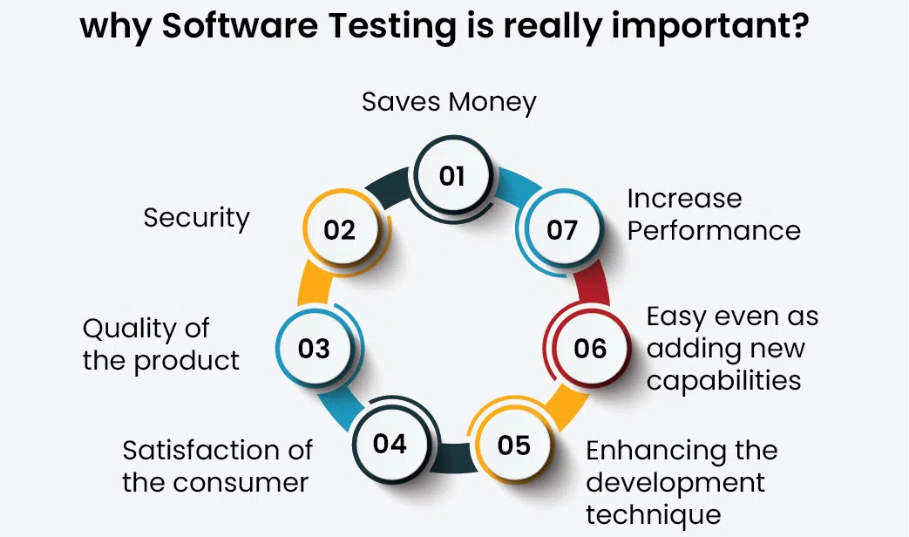
INTRODUCTION

Slide 4
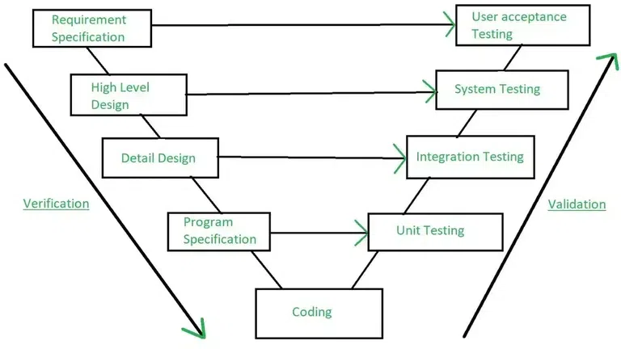
VERIFICATION and VALIDATION

Slide 5
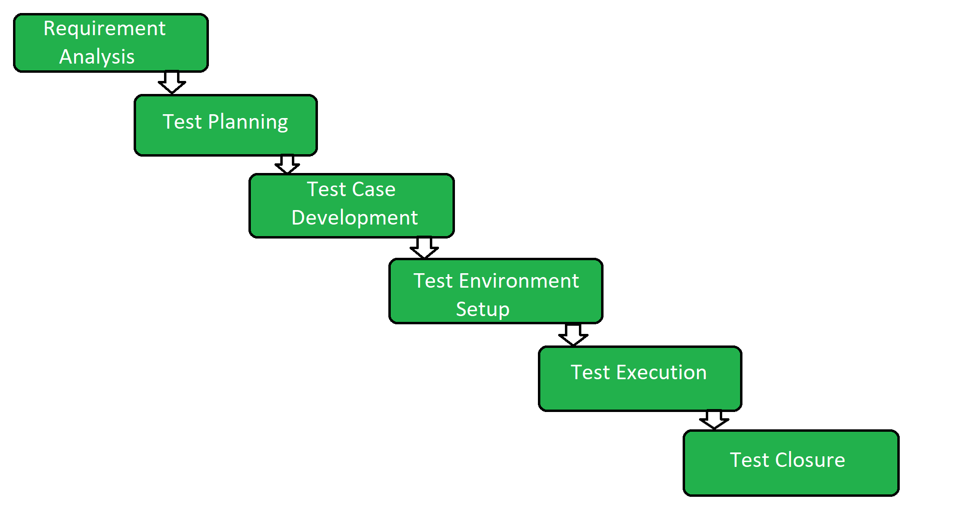
TESTING PHASES

Slide 6
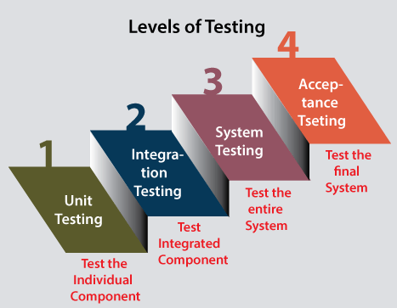

Slide 7
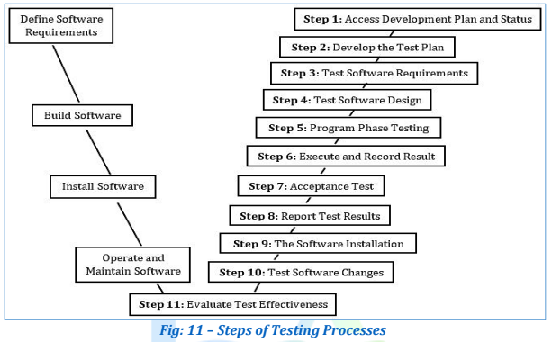
11 STEPS OF TESTING PROCESS

Slide 8
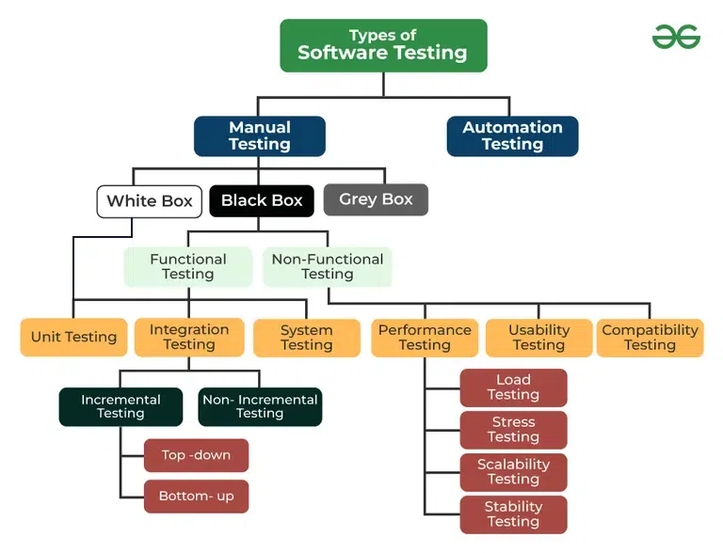

Slide 9
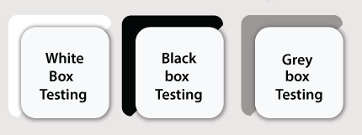
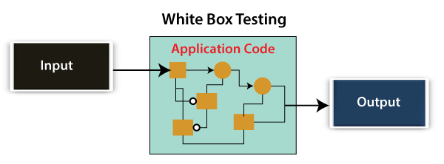
DIFFERENT TYPES OF MANUAL TESTING
White Box Testing
Developer will inspect every line of code before handing it over to the testing team or the concerned test engineers.
White box testing is also known as open box testing, glass box testing, structural testing, clear box testing, and transparent box testing.

Slide 10
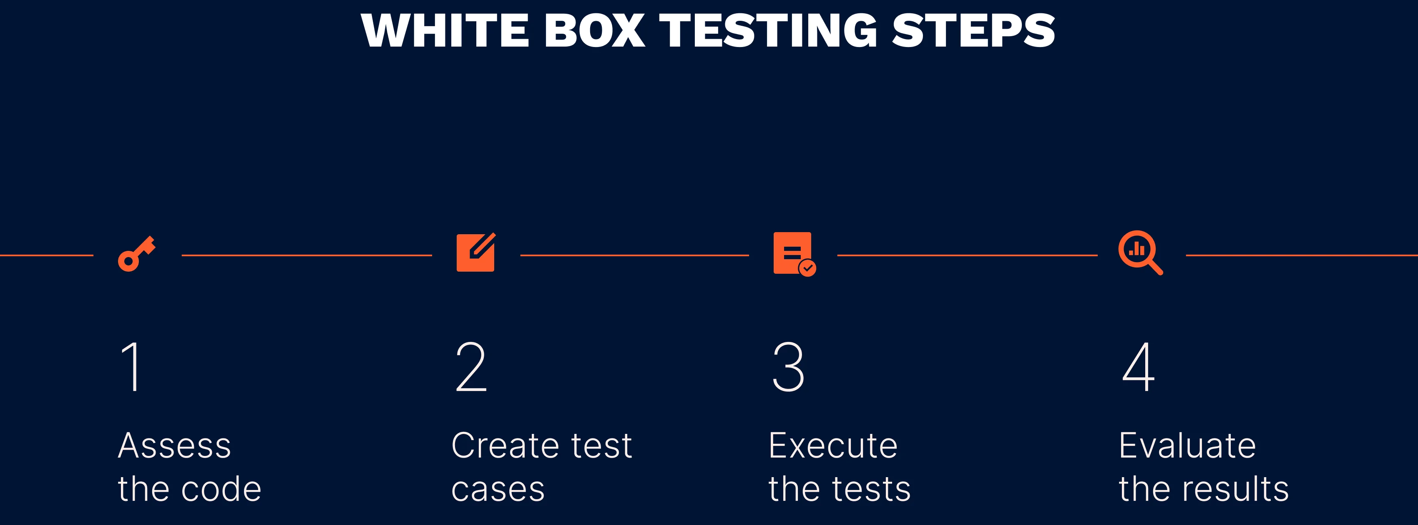
STEPS IN WHITE BOX TESTING

Slide 11
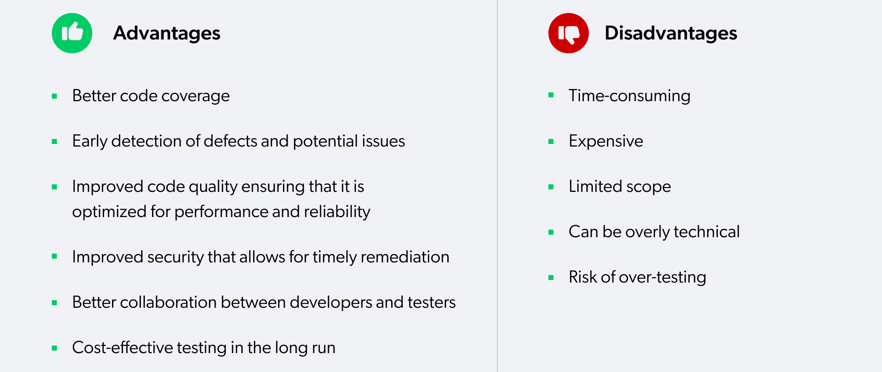
White Box Testing

Slide 12
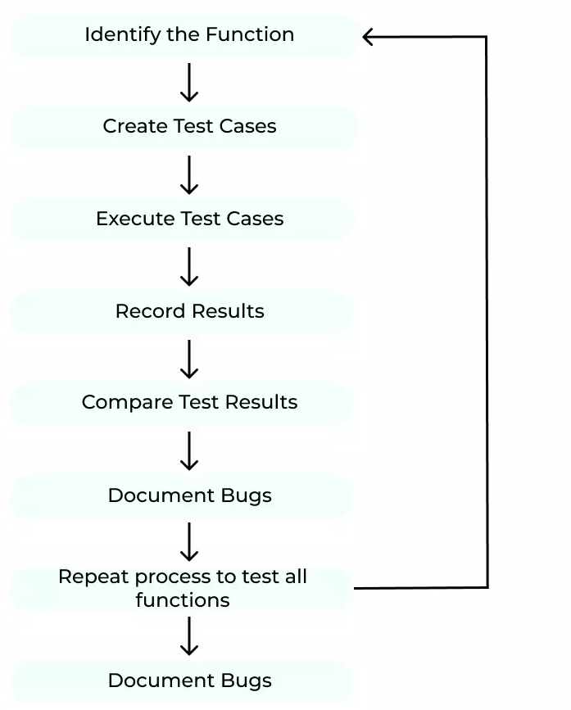
STEPS IN BLACK BOX TESTING

Slide 13
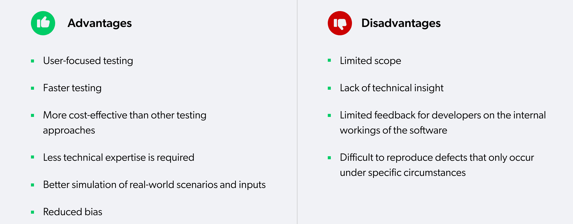
BLACK BOX TESTING

Slide 14
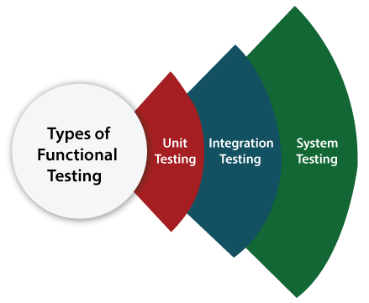
Types of Black Box Testing
Functional Testing
Non-function Testing
Functional Testing
check all the components systematically against requirement specifications is known as functional testing.
Functional testing is also known as Component testing.

Slide 15
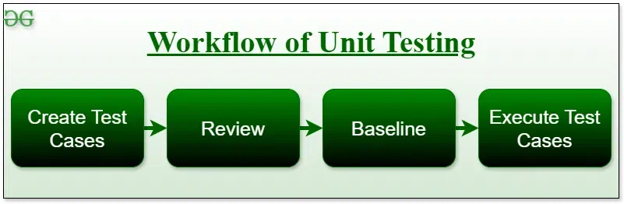
UNIT TESTING
software testing technique using individual units of software.
Unit Testing is defined as a type of software testing where individual components of a software are tested.
Objective of Unit Testing
To isolate a section of code.
To verify the correctness of the code.
To test every function and procedure.
To fix bugs early in the development cycle and to save costs.
To help the developers understand the code base and enable them to make changes quickly.
To help with code reuse.

Slide 16
UNIT TESTING
Unit Testing Techniques
There are 3 types of Unit Testing Techniques.
Black Box Testing: This testing technique is used in covering the unit tests for input, user interface, and output parts.
White Box Testing: This technique is used in testing the functional behavior of the system by giving the input.
Gray Box Testing: used in executing the relevant test cases, test methods, and test functions, and analyzing the code performance
Unit Testing Tools
Jtest
Junit
NUnit
EMMA
PHPUnit

Slide 17
UNIT TESTING
Advantages of Unit Testing
Early Detection of Issues:
Improved Code Quality:
Increased Confidence:
Faster Development:
Better Documentation:
Reduced Time and Cost:
Disadvantages of Unit Testing
Time and Effort:
Dependence on Developers:
Difficulty in Testing Complex Units:
Difficulty in Testing Interactions:
Difficulty in Testing User Interfaces:
Over-reliance on Automation:

Slide 18
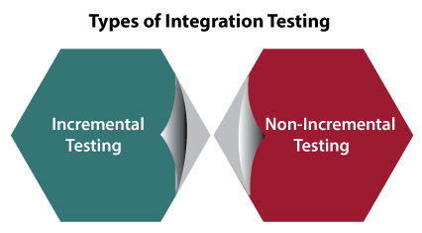
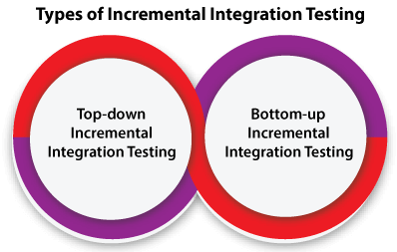

Slide 19
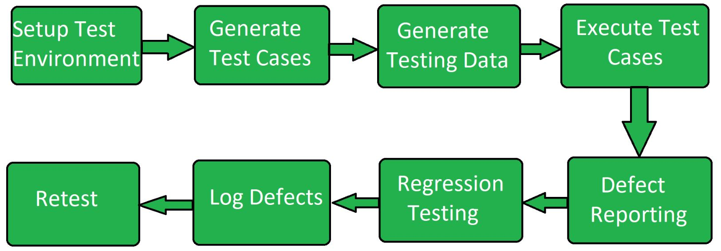
SYSTEM TESTING
series of different type of tests with the purpose to exercise and examine the full working of an integrated software computer system against requirements
includes testing of a fully integrated software system.
To check the end-to-end flow of an application or the software as a user is known as System testing.
System Testing Process

Slide 20
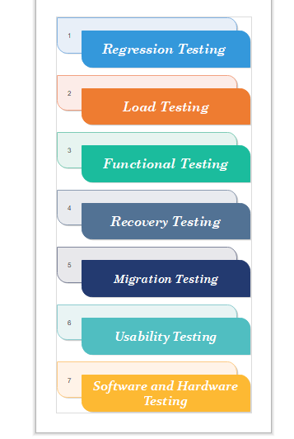
TYPES OF SYSTEM TESTING

Slide 21
TYPES OF SYSTEM TESTING
Regression testing:
It is performed under system testing to confirm and identify that if there's any defect in the system due to modification in any other part of the system.
2. Load Testing
Load testing is performed under system testing to clarify whether the system can work under real-time loads or not.
3. Recovery Testing
Recovery testing of a system is performed under system testing to confirm reliability, trustworthiness, accountability of the system and all are lying on recouping skills of the system.
4. Migration Testing
Migration testing is performed to ensure that if the system needs to be modified in new infrastructure so it should be modified without any issue.
5. Usability Testing
The purpose of this testing to make sure that the system is well familiar with the user and it meets its objective for what it supposed to do.
6.Functional Testing:
Type of testing that seeks to establish whether each application feature works as per the software requirements

Slide 22
TOOLS USED FOR SYSTEM TESTING
JMeter
Gallen Framework
Selenium
HP Quality Center/ALM
IBM Rational Quality Manager
Microsoft Test Manager
Selenium
Appium
LoadRunner
Gatling
JMeter
Apache JServ
SoapUI

Slide 23
PROS and CONS of SYSTEM TESTING
Advantages
It checks the overall functionality of a system
easily detects the bugs and finds defects.
helps to detect real-time bugs.
Disadvantages
time-consuming
expensive because it checks the full system.
challenging for large and complex systems.

Slide 24
NON-FUNCTIONAL TESTING
Non-functional testing is a software testing technique that checks the non-functional attributes of the system.
Major Types of Non-Functional Testing:
Performance Testing
Usability Testing
Compatibility Testing
Objectives of Non-functional Testing
Increased usability:
Reduction in production risk:
Cost Reduction:
Optimize installation:
Collect metrics:
Enhance knowledge of product:

Slide 25
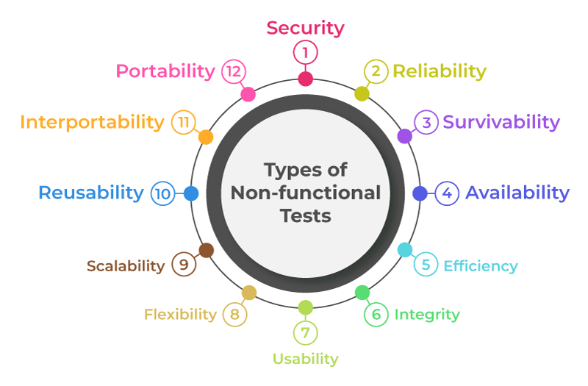
Non-functional Testing Parameters

Slide 26
Non-functional Testing Types
Performance Testing
Type of software testing that ensures software applications perform properly under their expected workload
Performance Testing Attributes:
Speed:
Scalability:
Stability:
Reliability:
Objective of Performance Testing:
To eliminate performance congestion.
To improve the product before launch in the market.
To make software rapid.
To make software stable and reliable.
To evaluate the performance and scalability

Slide 27
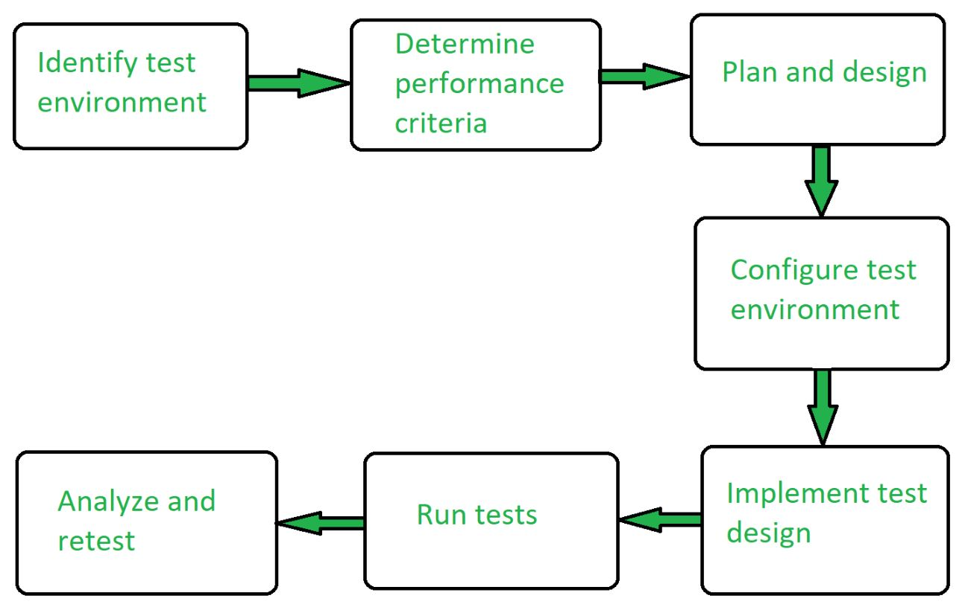
Performance Testing Process

Slide 28
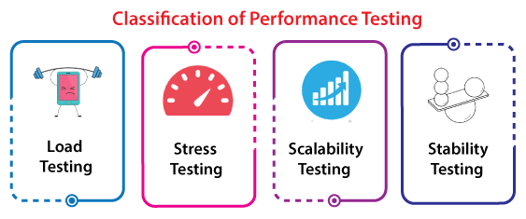
Performance Testing
Performance Testing Tools:
Jmeter
Open STA
Load Runner
Web Load
Advantages of Performance Testing :
Identifying bottlenecks:
Improved scalability:
Improved reliability:
Reduced risk:
Cost-effective:
Improved user experience:
Better Preparation:
Compliance:
Disadvantages of Performance Testing :
performance issues in the real-time environment.
high proficiency in debugging the test cases or test scripts.
Resource-intensive:
Complexity:
Limited testing scope:
Inaccurate results:
Difficulty in simulating real-world usage:
Complexity in analysing the results:

Slide 29
Performance Testing Types
Load Testing
Load testing determines the behaviour of the application when multiple users use it at the same time.
Objectives of Load Testing
Evaluation of Scalability:
Planning for Capacity:
Determine bottlenecks:
Analysis of Response Time:
Finding Memory Leaks:
Disadvantages of Load Testing
Resource-intensive:
Complexity:
Limited testing scope:
Inaccurate results:
Difficulty in simulating real-world usage:
Complexity in analysing the results:
Advantages of Load Testing
Identifying bottlenecks:
Improved scalability:
Improved reliability:
Reduced risk:
Cost-effective:
Improved user experience:

Slide 30
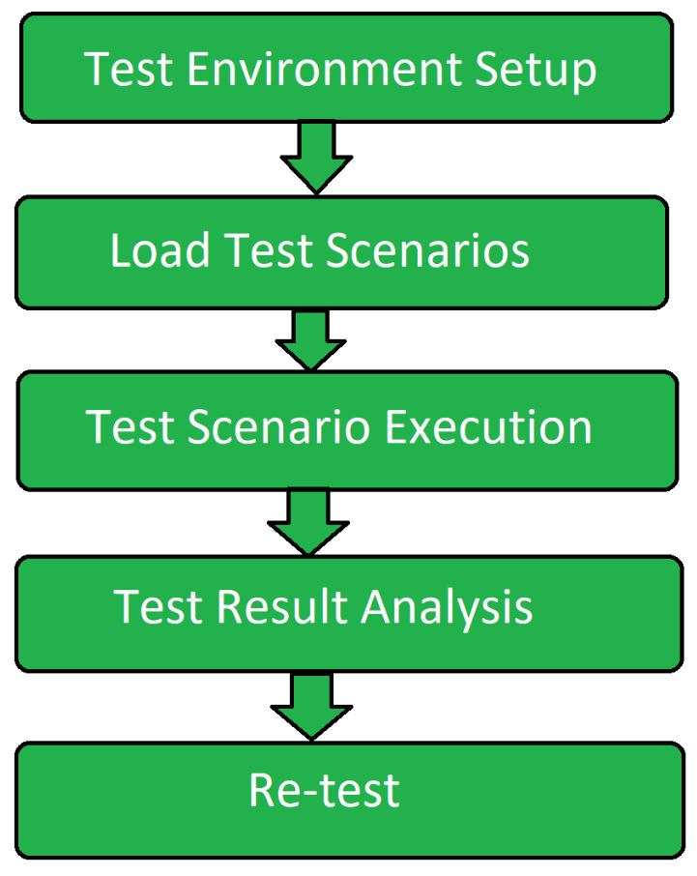
Load Testing Process

Slide 31
Stress Testing Process
software testing type that determines the robustness of software by testing beyond the limits of normal operation.
Objective of Stress Testing
Analyze the behavior of the application after failure:
System recovers after failure:
Uncover Hardware issues:
Uncover Security Weakness:
Ensures data integrity:
Benefits of Stress Testing
Determines the behavior of the system:
Ensure failure does not cause security issues:
Makes system function in every situation:
Improving Decision Making:
Increasing Stakeholder confidence:
Limitations of Stress Testing
Manual stress testing is complicated:
Good scripting knowledge required:
Need for external resources:
Constantly licensed tool:
Additional tool required in case of open-source stress testing tool:
Improper test script implementation results in wastage:

Slide 32
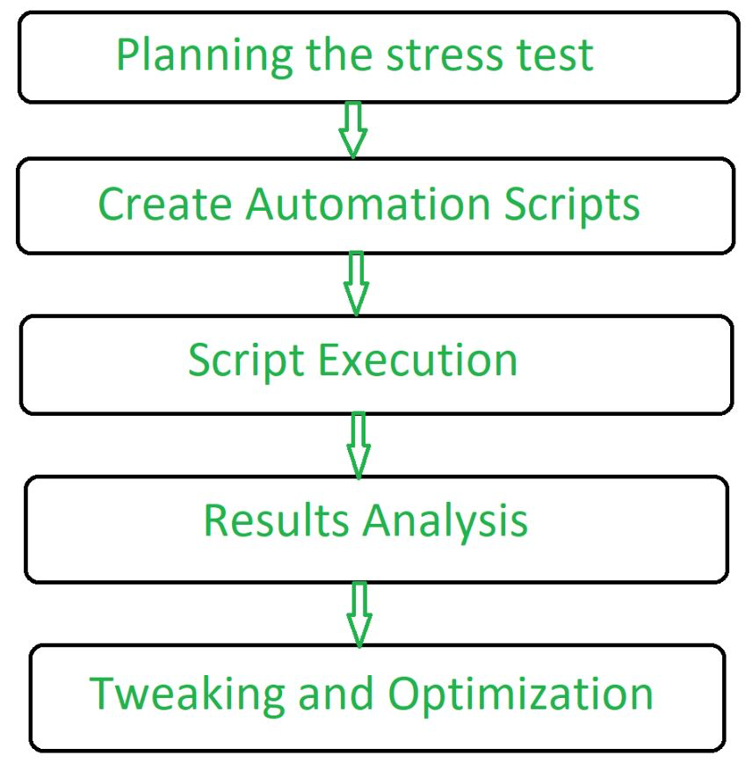
Stress Testing Process

Slide 33
Scalability Testing
Scalability Testing is defined as the ability of a network, system, application, product or a process to perform the function correctly when changes are made in the size or volume of the system to meet a growing need
Objective of Scalability Testing:
To determine how the application scales with increasing workload.
To determine the user limit for the software product.
To determine client-side degradation and end user experience under load.
To assess the system’s performance under various network circumstances,
To determine whether the system is capable of withstanding scenarios of high usage,
To guarantee that the system’s scalability
To determine server-side robustness and degradation.
To help developers improve the system design or code by pointing out bottlenecks
To evaluate the effective use of system resources
To make that the system satisfies performance criteria

Slide 34
Scalability Testing Process
Steps of Scalability Testing:
Define a process that is repeatable for executing scalability test.
Determine the criteria for scalability test.
Determine the software tools required to carry out the test.
Set the testing environment and configure the hardware required to execute a scalability test.
Create and verify visual script.
Create and verify the load test scenarios.
Execute the test.
Evaluate the result.
Generate required report.

Slide 35
Scalability Testing
Advantages of Scalability Testing:
It provides more accessibility to the product.
It detects issues with web page loading and other performance issues.
It finds and fixes the issues earlier in the product which saves a lot of time.
It ensures the end user experience under the specific load. It provides customer satisfaction.
It helps in effective tool utilization tracking.
Disadvantages of Scalability Testing:
Sometimes, it fails to find the functional errors or issues in the product.
Some automation tools used for Scalability testing is costlier
Team members involve in this testing technique should have high level of testing skills.
The time spent on testing some parts of product may consume more time than expected time.
Unexpected results may also be raised after launching the product in the customer environment.

Slide 36
Stability Testing
Type of Software Testing to check the quality and behavior of the software in different environmental parameters.
It is defined as the ability of the product to continue to function over time without failure.
Objective of the Stability Testing:
To yield confidence in the stability of the system or software application under test.
To ensure the system handling big programs.
To operate the effectiveness of the system or software application.
To check the stability of the system under stress.

Slide 37
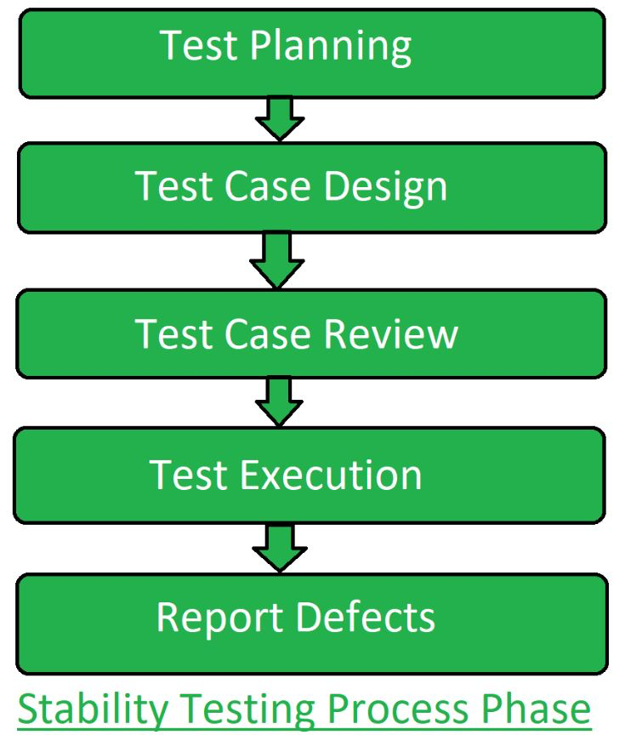
Stability Testing Process

Slide 38
Stability Testing
Advantages of Stability Testing:
It gives the limit of the data that a system can handle practically.
It provides the confidence on the performance of the system.
It determines the stability and robustness of the system under load.
Stability testing leads to a better end user experience.
Disadvantages of Stability Testing
the system might fail due to additional load on the CPU
The System fails shortly without implementing the stability testing and slows down the speed.
It works unusually when it goes to the changing environments.

Slide 39
2.Usability Testing
Checking the user-friendliness, efficiency, and accuracy of the application
features of usability testing are as follows:
Black-box testing technique in software testing.
Usability testing is performed throughout the system and acceptance testing levels.
Usability testing is implemented in the early stage of the Software Development Life Cycle (SDLC).
The execution of usability testing offers more visibility on the prospects of the end-users.
The usability testing makes sure that the software product meets its planned purpose.
It also helps us to find many usability errors in the specified software product.
tests the user-friendliness, usefulness, traceability, usability, and desirability of the final product.
It offers direct input on how real-users use the software/application.
Includes the systematic executions of the product's usability under a measured environment.

Slide 40
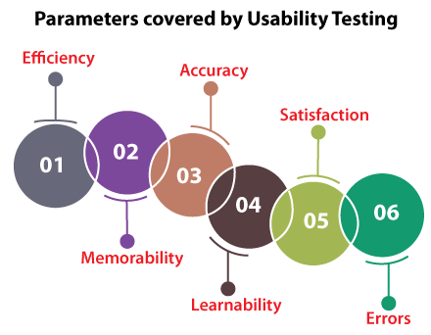
2.Usability Testing

Slide 41
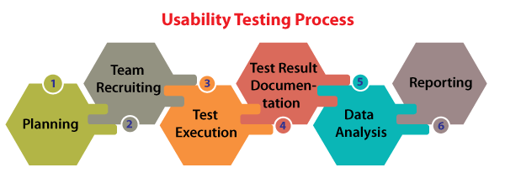

Slide 42
The Advantages of Usability Testing
Helps us to validate the usability of the software.
Its enhanced user satisfaction
Discover the usability issues before delivering the final product.
The end-user is always eager to use the application.
It improves the adequacy and consistency of the software product.
The Disadvantage of Usability Testing
Costly
harder to identify the volunteers who can work as test engineers.
Primarily, usability testing is not 100% representative of the actual condition.

Slide 43
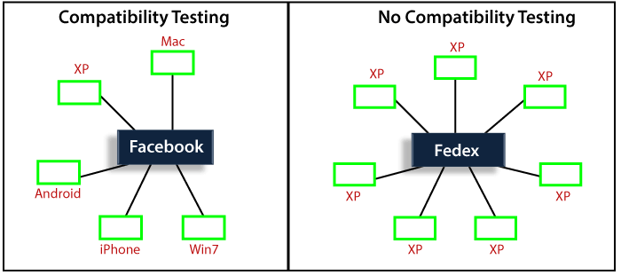
3. compatibility testing.
Checking the functionality of an application on different software, hardware platforms, network, and browsers

Slide 44
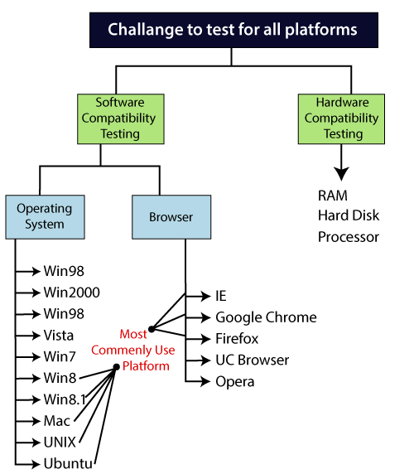
3. compatibility testing.
Types of Compatibility testing
Software
Hardware
Network
Mobile

Slide 45
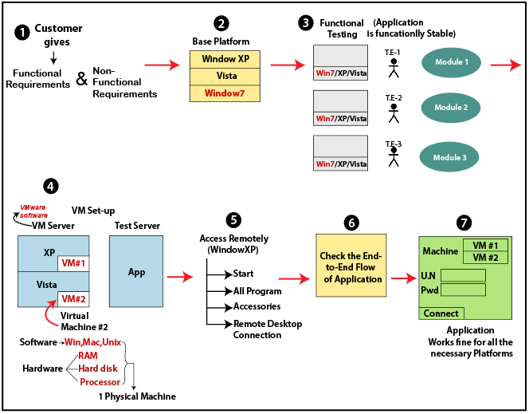
3. compatibility testing Process.

Slide 46
3. compatibility testing
Why compatibility testing is important?
It ensures complete customer satisfaction.
It provides service across multiple platforms.
Identifying bugs during development process.
Limitations
Variety of user interface.
Changes with respect to font size.
Alignment issues.
Issues related to existence of broken frames.
Issues related to overlapping of content.

Slide 47
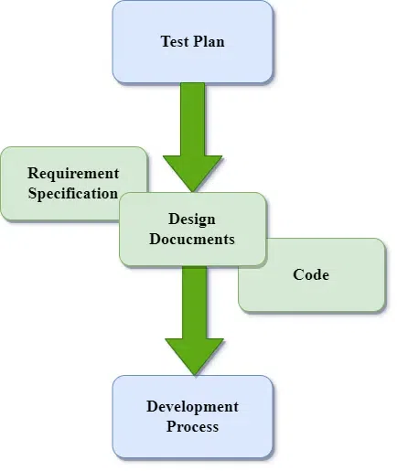
DEVELOPMENT TESTING

Slide 48
DEVELOPMENT TESTING
When to perform Development Testing?
When writing new code or building a new software product.
When development cost is low, the client should perform development Testing so that the client doesn’t have to face the debugging and another testing cost.
Benefits of Development Testing
Early Bug Detecting:
Savings on costs:
Improved Coding Quality:
Increased Output:
Easy Maintenance:
Disadvantages of Development Testing
Limitations on Time and Resources:
An excessive focus on unit testing:
False Feeling of Safety:
Dependence on tools for testing:
Insufficient User Input:
Tools required for Development Testing
Selenium
TestingWhiz
HPE Unified Functional Testing
Watir
Katalon Studio

Slide 49
TYPES OF DEVELOPMENT TESTING
1. Unit Testing
2. Component Testing
3. System Testing
Component Testing
Objective The objective of Component Testing is:
To verify the input and output behavior of the system.
To check the usability of each component.
To test the user comprehensibility of the software.
To test the state of the each components of the system.

Slide 50
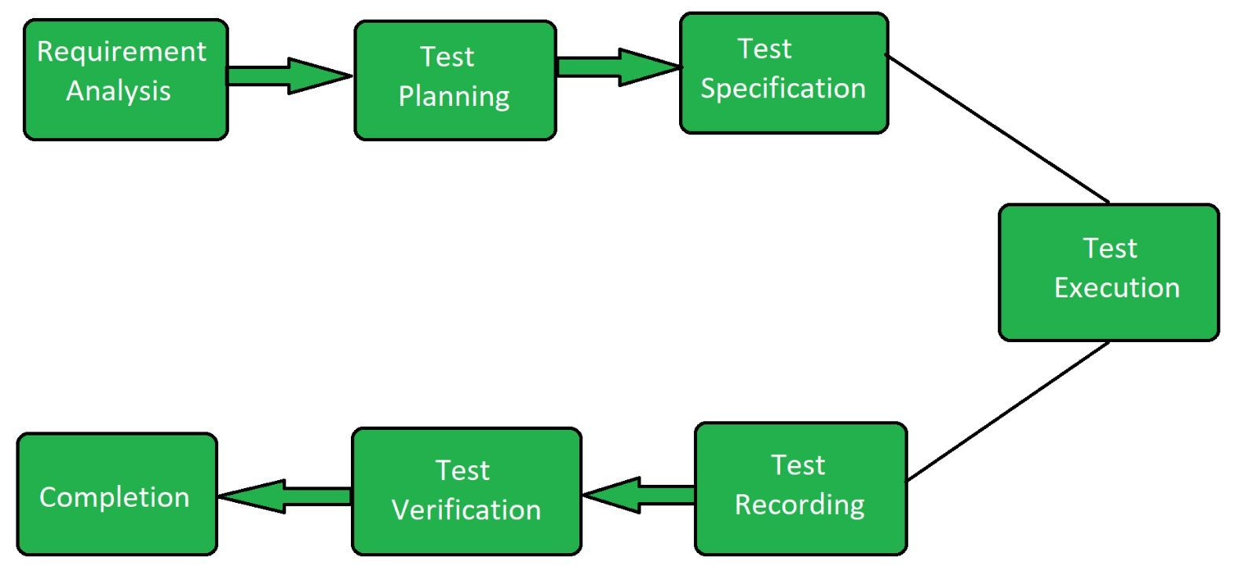
COMPONENT TESTING

Slide 51
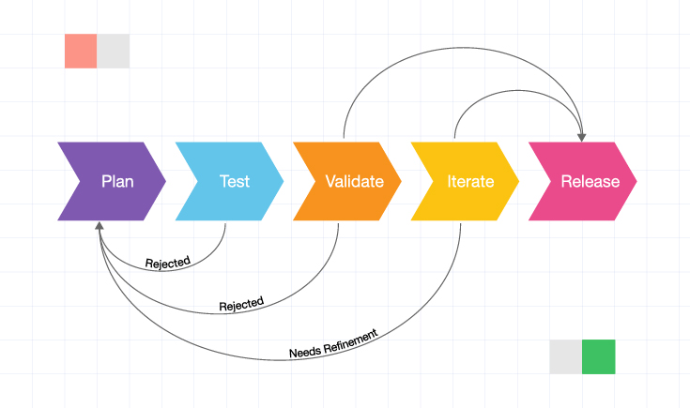
RELEASE TESTING

Slide 52
RELEASE TESTING
Why Release Testing?
To authenticate that the software works as per plan and fulfils the stipulated requirements.
To identify errors and eliminates the defects leading to failures.
To guarantees software compatibility with various hardware configurations, operating systems.
To assesses software’s performance under different contexts, including stress testing and peak usage.
To ensures that the software fulfils stated data privacy and security requirements.
To make the software more reliable and stable.

Slide 53
TYPES OF RELEASE TESTING
Functional testing:
This testing validates the software system against the functional specifications.
Performance Testing:
It evaluates the software product’s reliability, performance, speed, scalability, stability, resource consumption, and responsiveness of an application under load.
Security testing:
It evaluates threats, vulnerabilities, and risks in a software application.
Compatibility testing:
checks whether software can operate on various hardware, applications, browsers, mobile devices, network environments, or os.
Usability Testing:
It evaluates the software product’s utility and user experience
Regression Testing:
It helps validate that a code change in the software doesn’t influence the existing utility of the software product.
Automated Testing:
This release test technique automatically performs testing using software tools and scripts.
Unit Testing:
It aims to validate that each component/unit of the software functions as intended and fulfils the requirements.
End to End Testing:
End-to-end (E2E) testing verifies the working structure of a software product in a start-to-finish process.

Slide 54
BENEFITS OF RELEASE TESTING
Improves software product quality and performance:
Increases teamwork efficiency:
Decreases risks:
Cost-effective:
Increases customer satisfaction:
Better project management:

Slide 55
USER TESTING
User testing involves getting end users and customers to test and evaluate a product, feature, or prototype
Working of USER TESTING
Create a product, prototype, or feature.
Decide on a method of testing.
Recruit people to complete the test.
Determine a location to conduct the test.
Decide how long the test will take to complete.
Distribute the test.
Analyze test results.
User Testing Methods
Alpha Testing
Beta Testing
Acceptance Testing

Slide 56
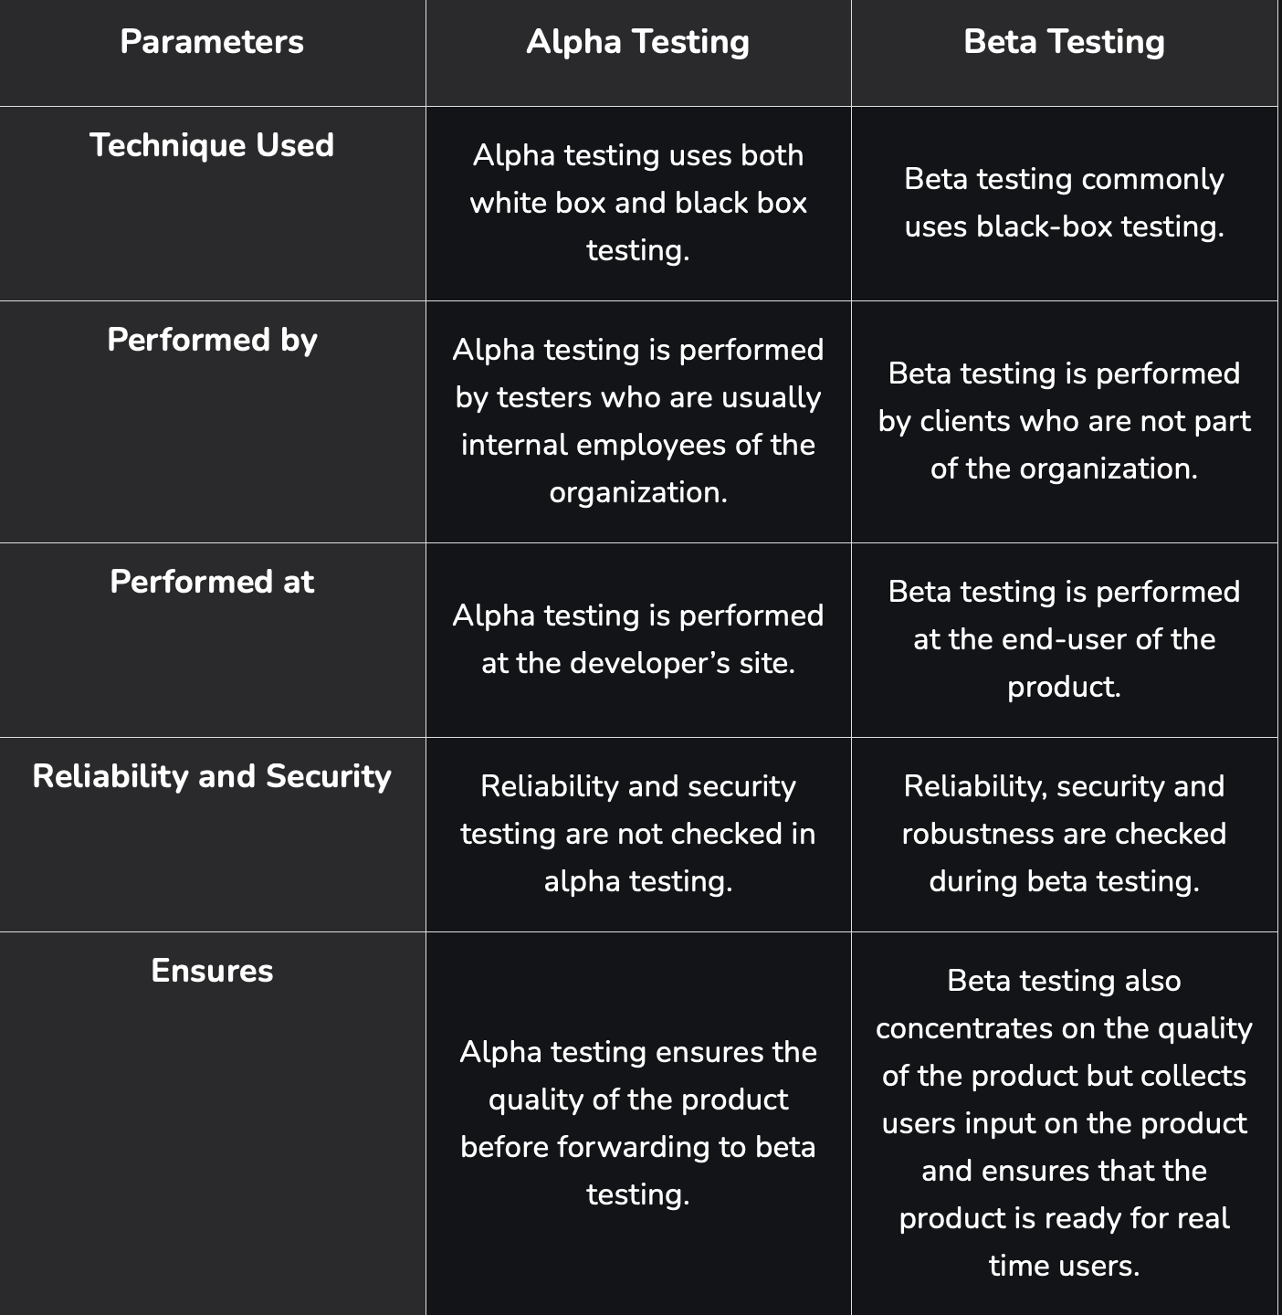
USER TESTING

Slide 57
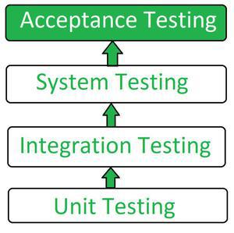
ACCEPTANCE TESTING
Flow of Acceptance Testing

Slide 58
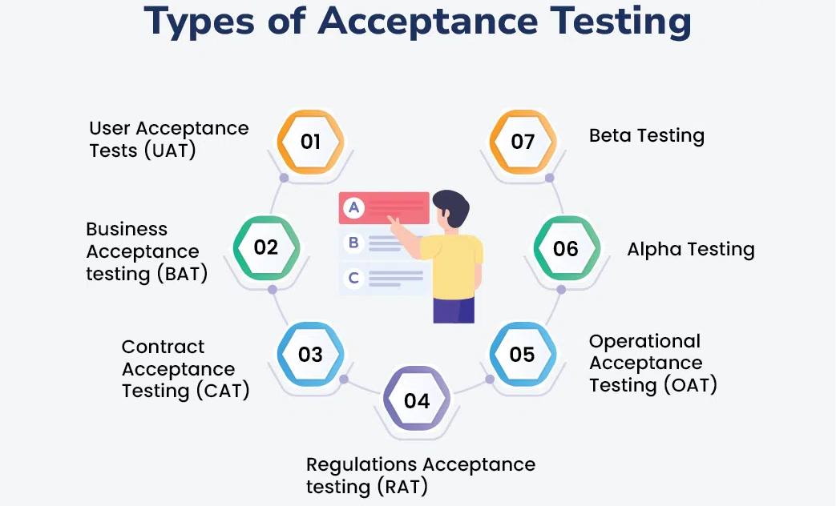
ACCEPTANCE TESTING

Slide 59
ACCEPTANCE TESTING
Advantages of Acceptance Testing
Helps to know the further requirements from the users directly
Automated test execution.
It brings confidence and satisfaction to the clients
It is easier for the user to describe their requirement.
It covers only the Black-Box testing process
Disadvantages of Acceptance Testing
Users should have basic knowledge about the product or application.
Sometimes, users don’t want to participate in the testing process.
The feedback for the testing takes a long time as it involves many users, and the opinions may differ from one user to another.
Development team is not participated in this testing process.

Slide 60
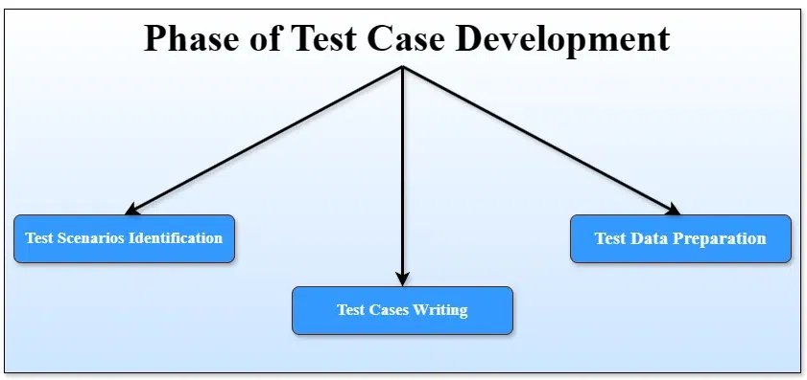
TEST CASE DEVELOPMENT STRATEGIES

Slide 61
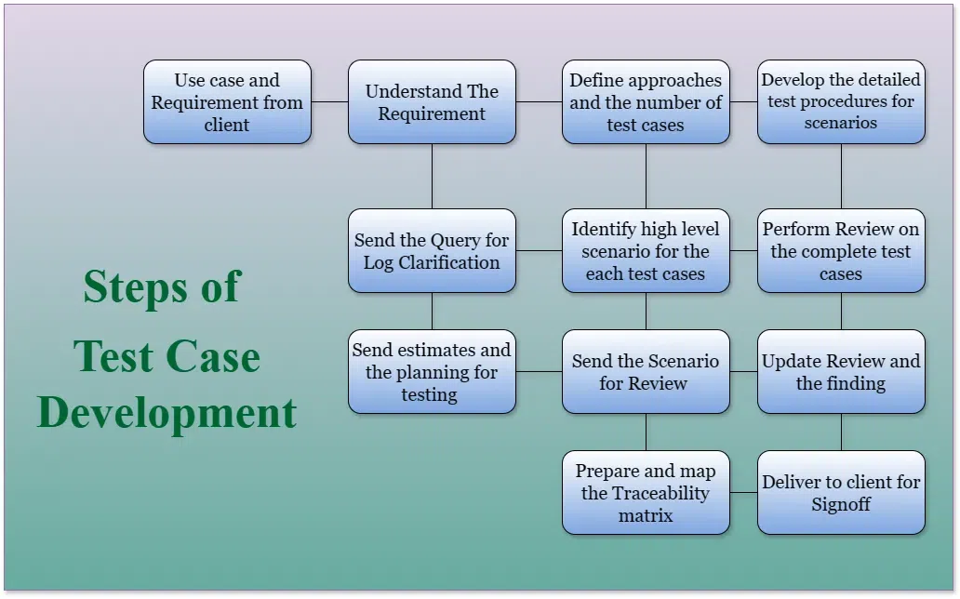
TEST CASE DEVELOPMENT STRATEGIES

Slide 62
TEST CASE DEVELOPMENT STRATEGIES/TECHNIQUES
Boundary Value Analysis (BVA):
This technique involves designing test cases around the boundary values of input domains.
For instance, if an input field accepts numbers from 1 to 100, test cases should include values like 0, 1, 100, and 101 to check the system's handling of boundary conditions.
Equivalence Partitioning:
Here, input data and output results are divided into equivalent groups that should be treated the same by the software.
By testing a single value from each group, you can infer the behavior for all values in that partition, reducing the number of test cases needed.
Decision Table Testing:
This technique is useful for functions with logical relationships between inputs.
A decision table lists inputs and their corresponding outputs, helping to design test cases that cover combinations of conditions and actions.
Use Case Testing:
This technique bases test cases on use cases, which describe how users interact with the application to achieve a goal.
It helps ensure that all user interactions and flows are tested.

Slide 63
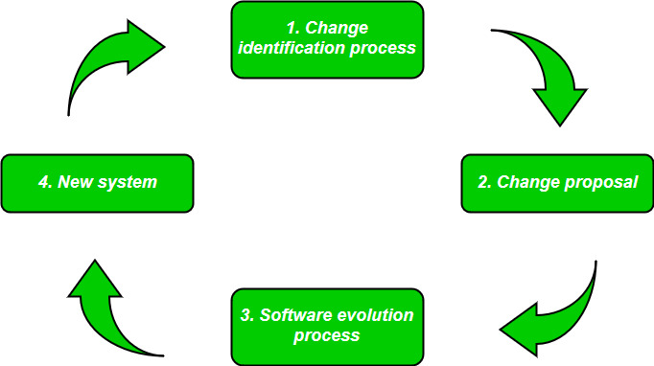
SOFTWARE EVOLUTION
Refers to the process of developing software initially, and then timely updating it for various reasons.

Slide 64
SOFTWARE EVOLUTION
Necessity of Software Evolution
Change in requirement with time:
Environment change:
Errors and bugs:
Security risks:
For having new functionality and features:

Slide 65
LAWS USED FOR SOFTWARE EVOLUTION
1. Law of Continuing Change
Any software system that represents some real-world reality undergoes continuous change or become progressively less useful in that environment.
2. Law of Increasing Complexity
As an evolving program changes, its structure becomes more complex unless effective efforts are made to avoid this phenomenon.
3. Law of Conservation of Organization Stability
The rate of development of the program is approximately constant and independent of the resource devoted to system development.
4. Law of Conservation of Familiarity
This law states that during the active lifetime of the program, changes made in the successive release are almost constant.

Slide 66
SOFTWARE CHANGES
Software change refers to the process of modifying or adapting software after it has been deployed.
Types of Software Changes
Corrective Changes:
Address issues like bugs, defects, or errors in the software.
Adaptive Changes:
Adapt the software to changes in its environment, such as operating systems, hardware, or external dependencies.
Perfective Changes:
Improve the functionality, performance, or usability of the software.
Preventive Changes:
Focus on improving maintainability and preventing future issues.
Software Change Process
Change Request:
Impact Analysis:
Change Approval:
Implementation:
Testing:
Deployment:
Review and Documentation:

Slide 67
SOFTWARE MAINTENANCE PROCESS
It stands for all the modifications and updations done after the delivery of software product.
Reasons for modifications:
Market Conditions
Client Requirements
Host Modifications
Organization Changes
TYPES OF MAINTENANCE
Corrective Maintenance
Adaptive Maintenance
Perfective Maintenance
Preventive Maintenance

Slide 68
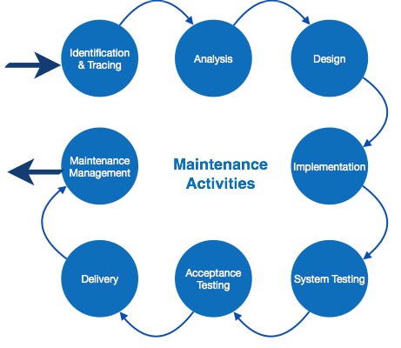
SOFTWARE MAINTENANCE PROCESS

Slide 69
SOFTWARE RE-ENGINEERING
Process of analyzing, designing, and modifying existing software systems to improve their quality, performance, and maintainability.
Objective of Re-engineering
To describe a cost-effective option for system evolution.
To describe the activities involved in the software maintenance process
To distinguish between software and data re-engineering and to explain the problems of data re-engineering.

Slide 70
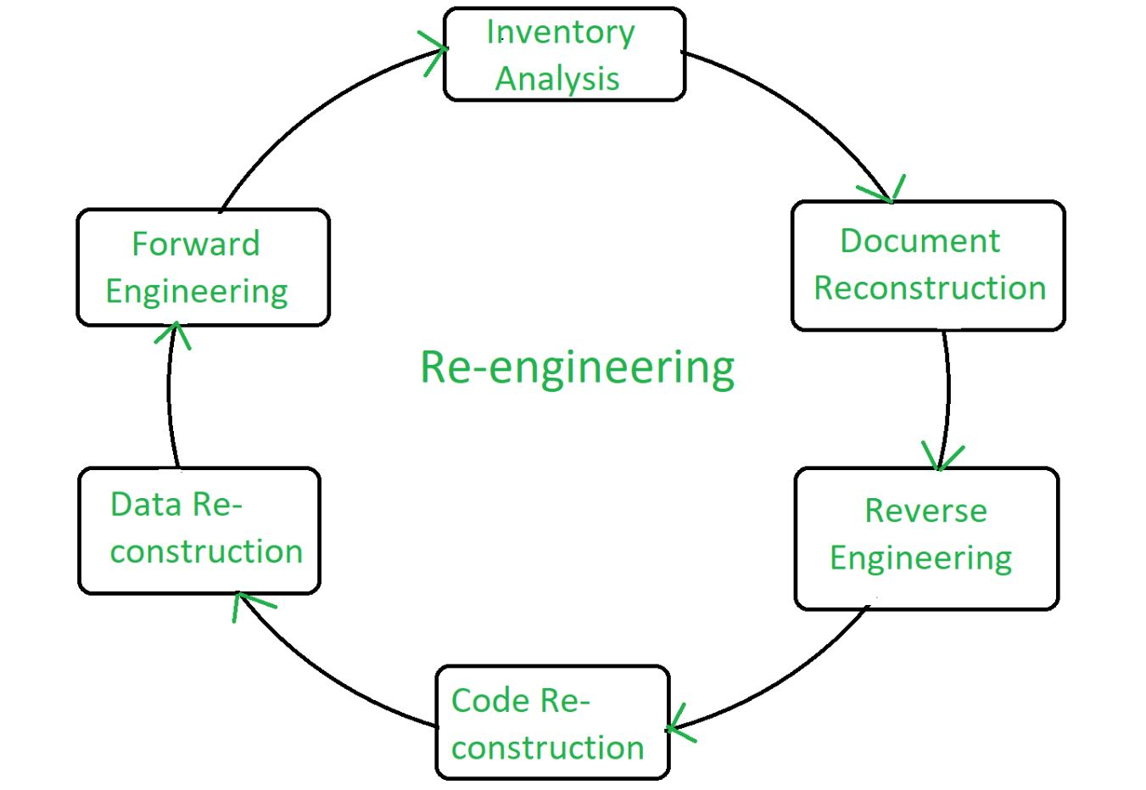
STEPS IN SOFTWARE RE-ENGINEERING

Slide 71
WHY SOFTWARE RE-ENGINEERING
To improve the software’s performance and scalability:
To add new features:
To support new platforms:
To improve maintainability:
To meet new regulations and compliance:
Improving software quality:
Updating technology:
Enhancing functionality:
Resolving issues:

Slide 72
ADVANTAGES OF RE-ENGINEERING
DISADVANTAGES OF RE-ENGINEERING
High costs:
Disruption to business operations:
Resistance to change:
Risk of failure:
Lack of employee involvement:
Difficulty in measuring success:
Difficulty in maintaining continuity:
Reduced Risk:
Reduced Cost:
Better use of Existing Staff:
Improved efficiency:
Increased flexibility:
Better customer service:

Slide 73
END OF THE UNIT

Slide 74
THANK YOU

